Slide 1
INTELLIGENT TRAFFIC SIGNAL
CONTROLLER
With Pedestrian Input & Emergency Override
Embedded Systems Design (ESD) & Internet of Things (25EC2206E)
NUCLEO-F103RB • GPIO • TIM2 • EXTI/NVIC • UART
Team members :
251008001 - Yeswanth
2510080012 - Sai Vignesh
2510080022 - Niharika
2510080049 - Tejaswini
2510080054 - Krithik Reddy
2510080011 - Srujan Reddy
2510080056 - Ruthvik Yerram
KLEF | AI & DS

Slide 2
INTELLIGENT TRAFFIC SIGNAL CONTROLLER
Problem Statement & Objectives
A traffic controller must sequence signals safely while responding to asynchronous inputs.
NORMAL SEQUENCE
PEDESTRIAN REQUEST
EMERGENCY OVERRIDE
RED → GREEN → YELLOW
Target: 5 s / 5 s / 2 s
Capture a button press and serve it at a safe point.
Prioritize the emergency event and command a safe output.
• Configure GPIO outputs for the three traffic LEDs.
• Use a hardware timer and finite-state machine instead of blocking delays.
• Integrate EXTI/NVIC, an IR vehicle sensor, relay output and UART status.
ESD & IoT • Project Based Learning
02

Slide 3
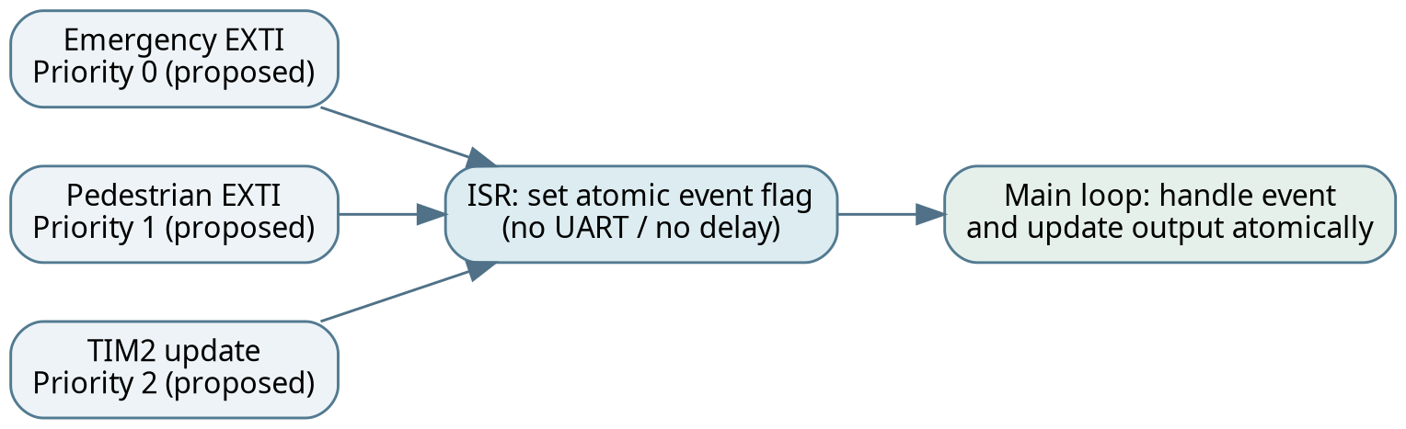
INTELLIGENT TRAFFIC SIGNAL CONTROLLER
Hardware Platform
The supplied report identifies the photographed board as NUCLEO-F103RB.
• STM32F103RB microcontroller board
• Breadboard, jumper wires and current-limited LEDs
• Push button for pedestrian input
• Digital IR sensor for vehicle-presence detection
• Relay module for simulated emergency output
• USB connection for power and programming
Photo evidence confirms physical assembly; exact pin mapping must come from the CubeMX .ioc file.
ESD & IoT • Project Based Learning
03

Slide 4
INTELLIGENT TRAFFIC SIGNAL CONTROLLER
System Architecture
Pedestrian
Button
RED / YELLOW / GREEN LEDs
STM32F103RB
Finite-State Machine
TIM2 + EXTI / NVIC
IR Vehicle
Sensor
Emergency Relay
Emergency
Input
UART Status / Logging
Inputs → event capture → control decision → outputs
ESD & IoT • Project Based Learning
04

Slide 5
INTELLIGENT TRAFFIC SIGNAL CONTROLLER
Finite-State Machine
RED
GREEN
YELLOW
RED
5 seconds
5 seconds
2 seconds
repeat
PEDESTRIAN EVENT
EMERGENCY EVENT
Latch request; serve at a safe RED boundary.
Override normal timing; proposed safe pattern is all-red + relay.
The timing values are design targets, not measured results in the supplied evidence.
ESD & IoT • Project Based Learning
05

Slide 6
INTELLIGENT TRAFFIC SIGNAL CONTROLLER
Timer-Based Signal Timing
Target cycle: 5 s RED + 5 s GREEN + 2 s YELLOW = 12 seconds
RED
GREEN
YELLOW
5s
5s
2s
TIMER FORMULA
ILLUSTRATIVE 1 ms TICK
f_update = f_timer / [(PSC + 1) × (ARR + 1)]
If TIM2CLK = 72 MHz: PSC = 7199, ARR = 9
Important: verify the actual RCC/APB timer clock in CubeMX before using these values.
ESD & IoT • Project Based Learning
06

Slide 7
INTELLIGENT TRAFFIC SIGNAL CONTROLLER
Inputs, Interrupts & Emergency Handling
EXTI — PEDESTRIAN
IR SENSOR
EMERGENCY
Button edge is captured promptly. ISR sets a pending flag; main logic decides when it is safe to serve.
Digital input indicates object present/absent. Confirm polarity and 3.3 V compatibility.
Highest-priority event. Proposed response: all-red traffic output and relay activation.
Interrupt design principles
• Keep ISRs short: record events, then return.
• Avoid blocking delays and UART transmission inside interrupts.
• Use one output-update function to preserve safe lamp combinations.
ESD & IoT • Project Based Learning
07

Slide 8
INTELLIGENT TRAFFIC SIGNAL CONTROLLER
Implementation Workflow
1
2
3
Configure GPIO
Configure TIM2
Build FSM
Test each LED independently
Verify tick with counter/debug output
Check RED → GREEN → YELLOW
4
5
6
Add EXTI
Integrate modules
Validate
Latch and debounce button events
IR, relay, UART and event priority
Capture timing and functional evidence
Recommended test order: outputs first, timer second, integrated events last.
ESD & IoT • Project Based Learning
08

Slide 9
INTELLIGENT TRAFFIC SIGNAL CONTROLLER
Prototype & Observed Evidence
RED LIGHT
GREEN LIGHT
Observed: physical NUCLEO-F103RB setup; red and green LEDs illuminated in separate photos.
Photos do not independently prove exact timing, EXTI/NVIC behavior, UART output or relay contact actuation.
ESD & IoT • Project Based Learning
09

Slide 10
INTELLIGENT TRAFFIC SIGNAL CONTROLLER
Results: What Is Verified vs. Pending
OBSERVED / SUPPORTED
NEEDS VERIFICATION
• Hardware assembled and powered
• Red LED visibly illuminated
• Green LED visibly illuminated
• 5 / 5 / 2 s timing trace
• Pedestrian EXTI and debounce
• IR detection polarity and response
• Relay contact switching and UART log
Evidence standard
• Use timestamped UART logs or an oscilloscope/logic analyzer for timing.
• Test emergency preemption while a normal state is active.
• Complete the actual pin map from the project .ioc file.
ESD & IoT • Project Based Learning
10

Slide 11
INTELLIGENT TRAFFIC SIGNAL CONTROLLER
Conclusion
Key takeaway
A timer-driven finite-state machine provides a structured foundation for responsive, event-driven traffic control.
THANK YOU
Educational prototype only — not intended for deployment on public roads.
ESD & IoT • Project Based Learning
11

